Slide 1
LZW Compression & Decompression
Shaun Holtzman – SHH117@Pitt.edu
Travis Wise – TWW12@Pitt.edu

Slide 2
LZW Compression
Universal lossless data compression algorithm
Created by Abraham Lempel, Jacob Ziv, and Terry Welch
Dictionary based compression algorithm
Simple to implement
Potential for high throughput in hardware implementations
Portable
Algorithm of the widely used Unix file compression utility compress
Used in the GIF image format

Slide 3
Hardware Design
Input data put into input FIFO by software
Hardware decompresses data as it arrives in the input FIFO
Hardware decompresses input data and places compressed output into the output FIFO
Software reads the compressed data from the output FIFO and decompresses the compressed data

Slide 4
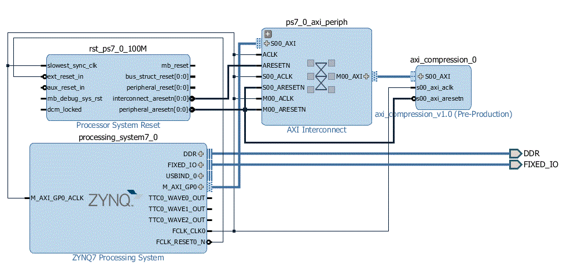
Hardware Design
Hardware/software connection done using AXI
Allows the software to access the addresses of desired signals

Slide 5
Accomplishments Since Baseline Demo
Parallelized the dictionary search
Dictionary search can be done with multiple separate BRAMs
1, 2, or 4 BRAMS
Counter added to count number of clock cycles to compress data
Counter starts as soon as the first value is written into the input FIFO
Counter stops once the compression’s done signal goes true

Slide 6
Parallelizing the Search
Original algorithm performs many searches through a 4096-entry BRAM serially, which takes up most of the time
By breaking up the dictionary search into multiple BRAMS we can get near-linear speedup on our searches
Each address for the BRAM is interlaced between the separate blocks
E.g. address 0 corresponds to address 0 in block 0, address 1 corresponds to address 0 in block 1
New dictionary entries are written round-robin style

Slide 7
Code Changes
Monolithic dictionary VHDL file broken into two files
dictionary_block
dictionary.vhd
dictionary_block stores the BRAM and conducts the searches on that particular BRAM
Dictionary orchestrates the writes to the BRAMs by enabling the correct BRAM
Dictionary combines the signals from the four blocks when appropriate

Slide 8
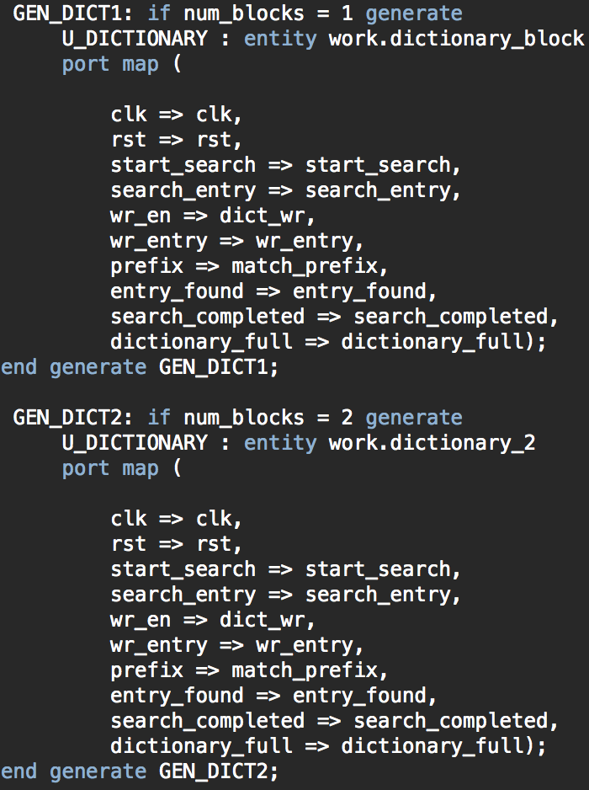
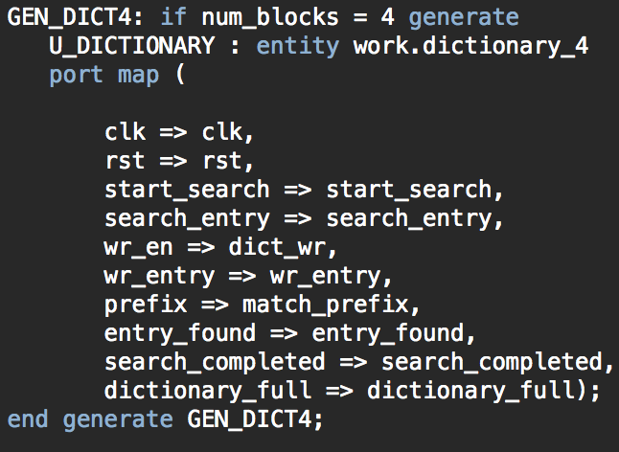
Dictionary

Slide 9
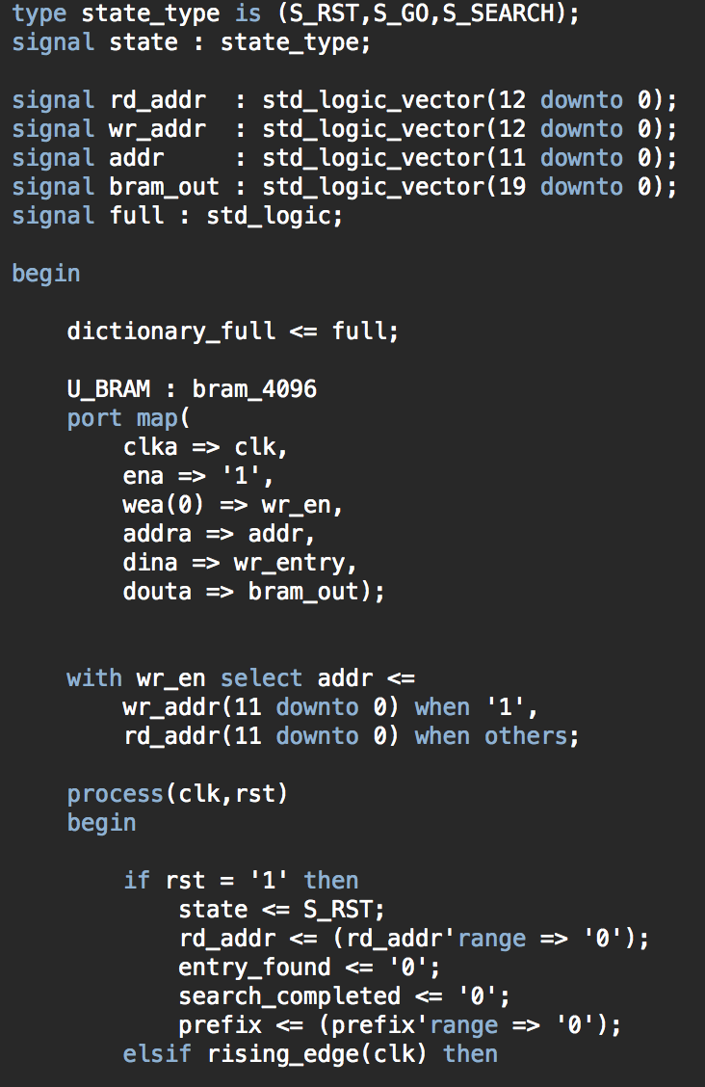
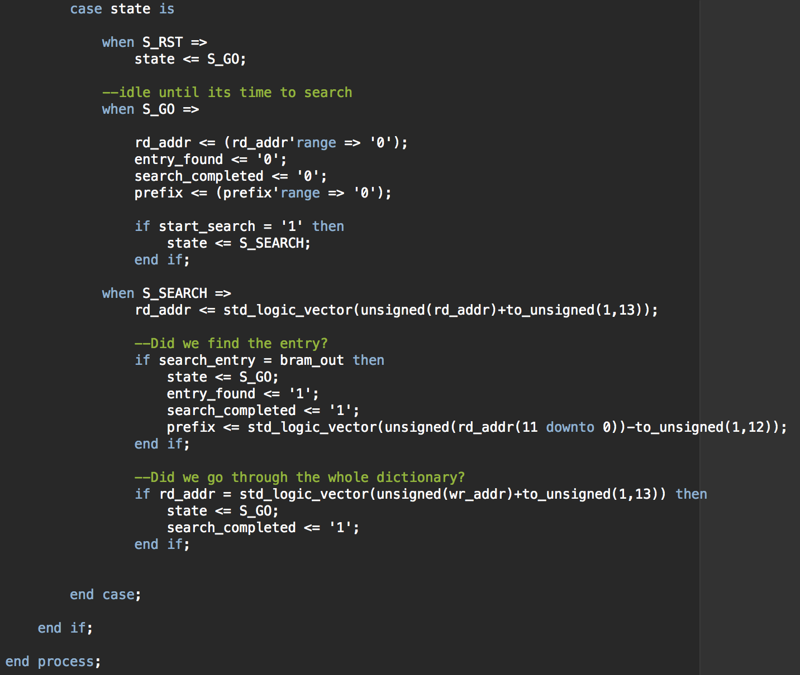
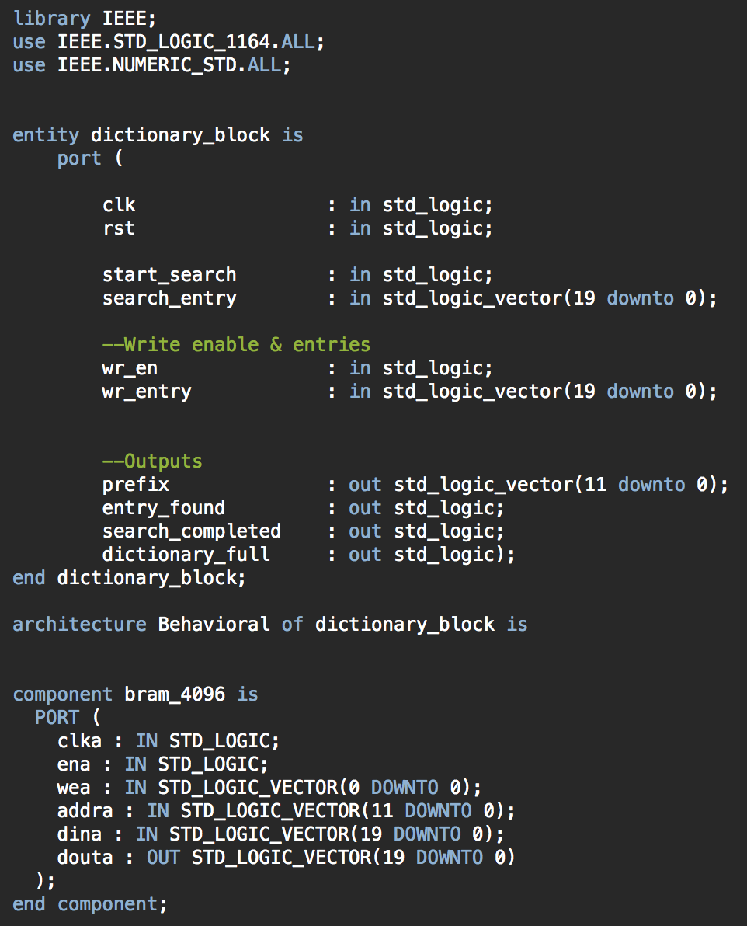
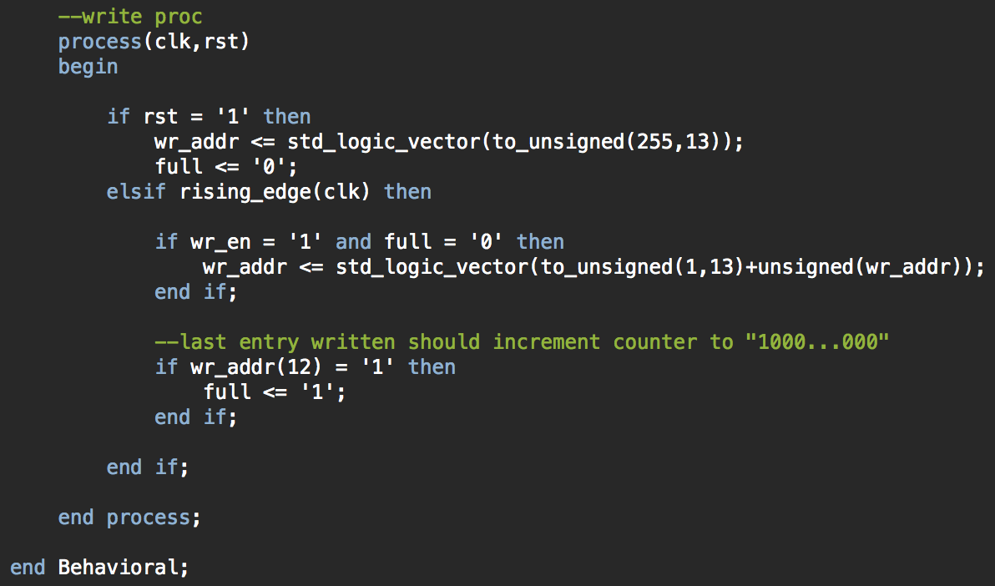
Dictionary – One Dictionary Block

Slide 10
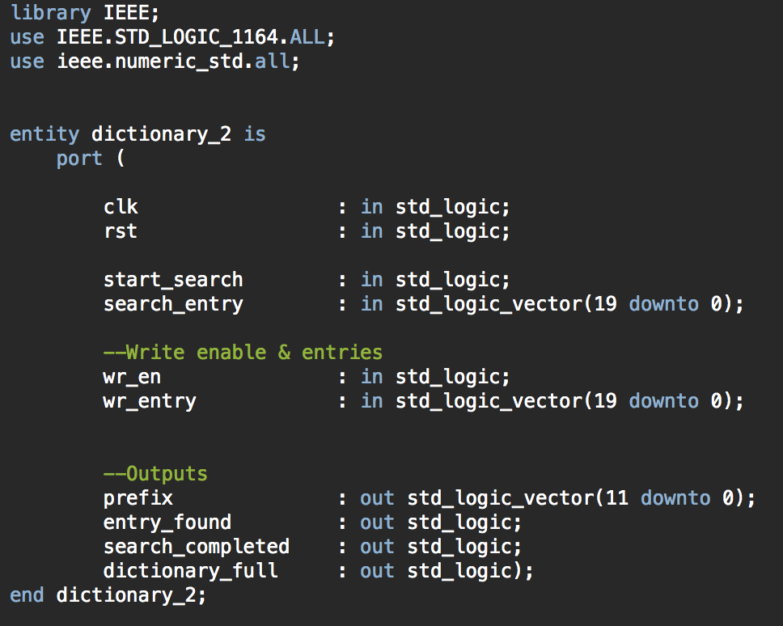
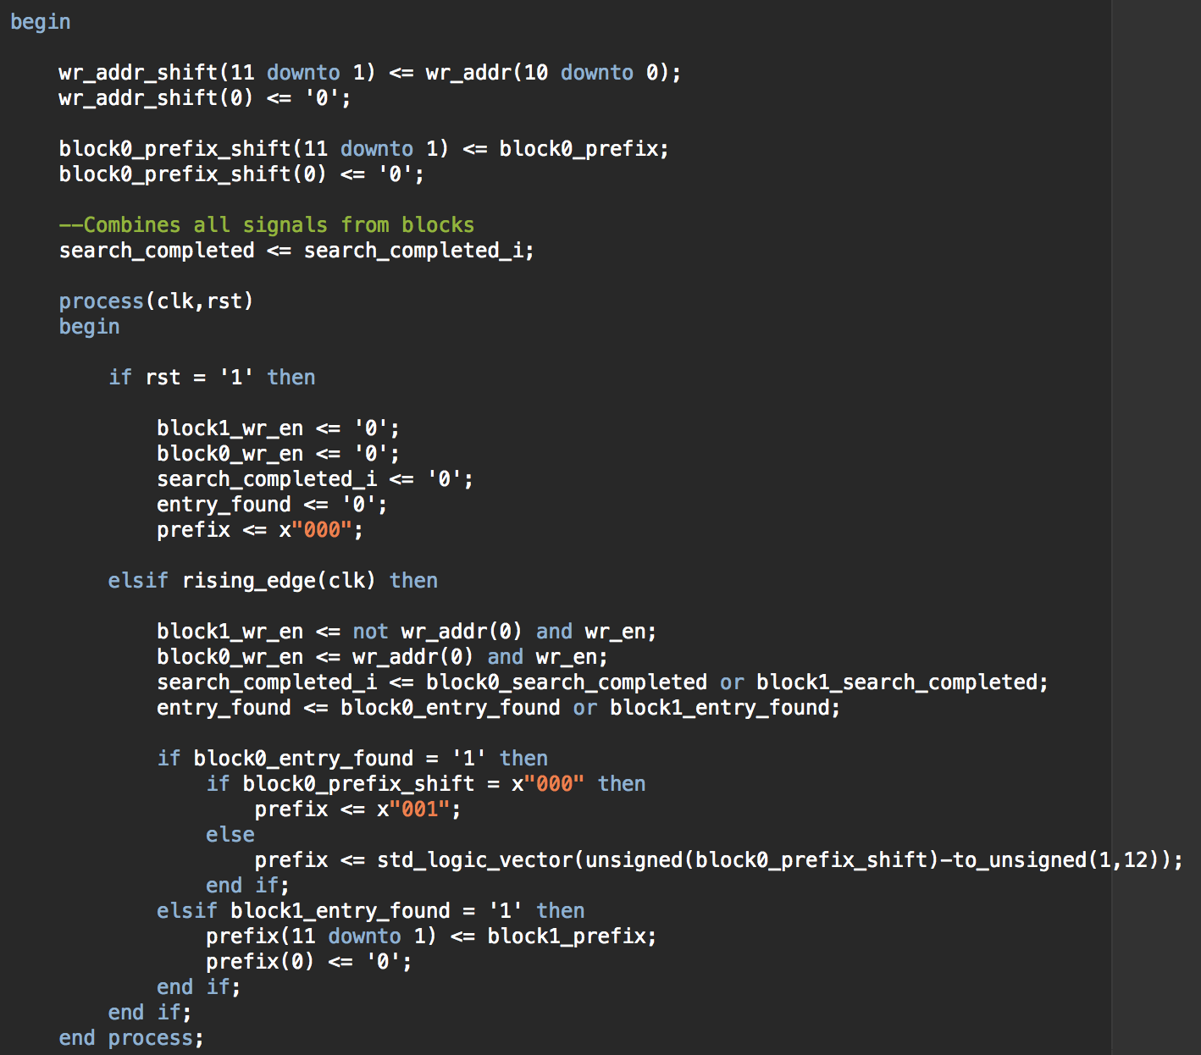
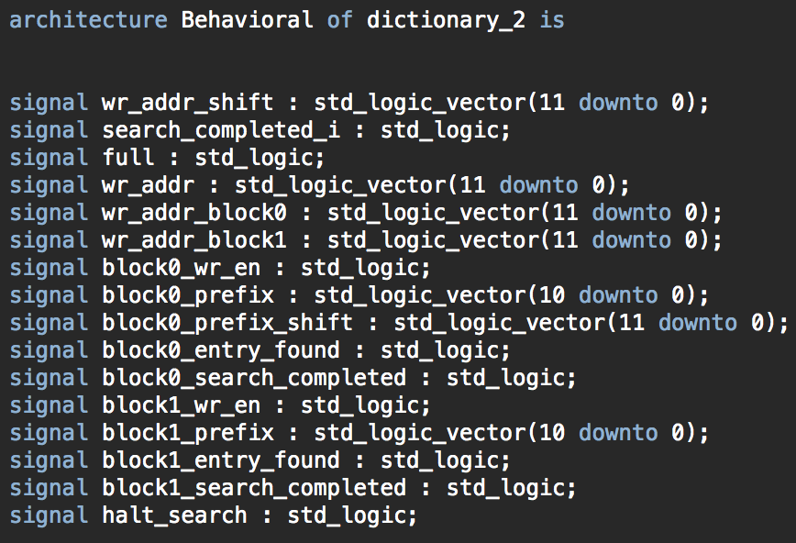
Dictionary – Two Dictionary Blocks

Slide 11
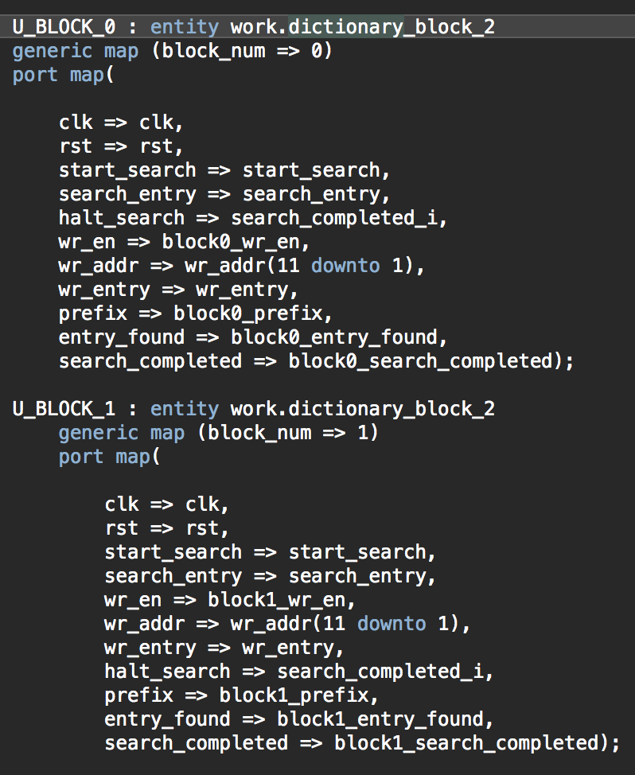
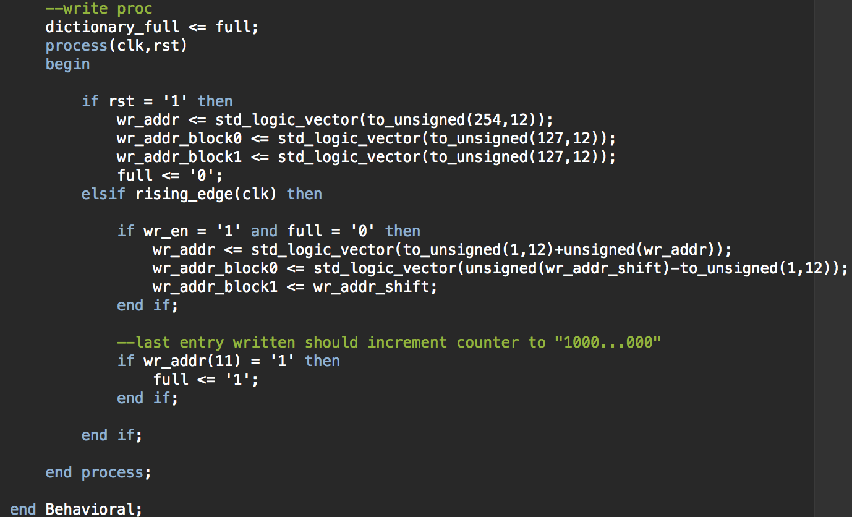
Dictionary – Two Dictionary Blocks

Slide 12
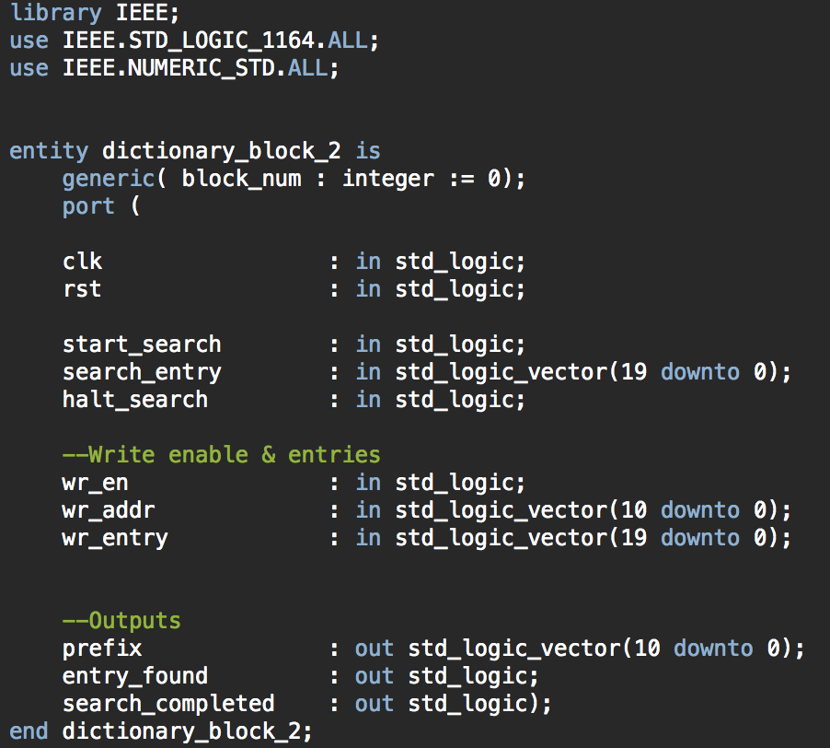
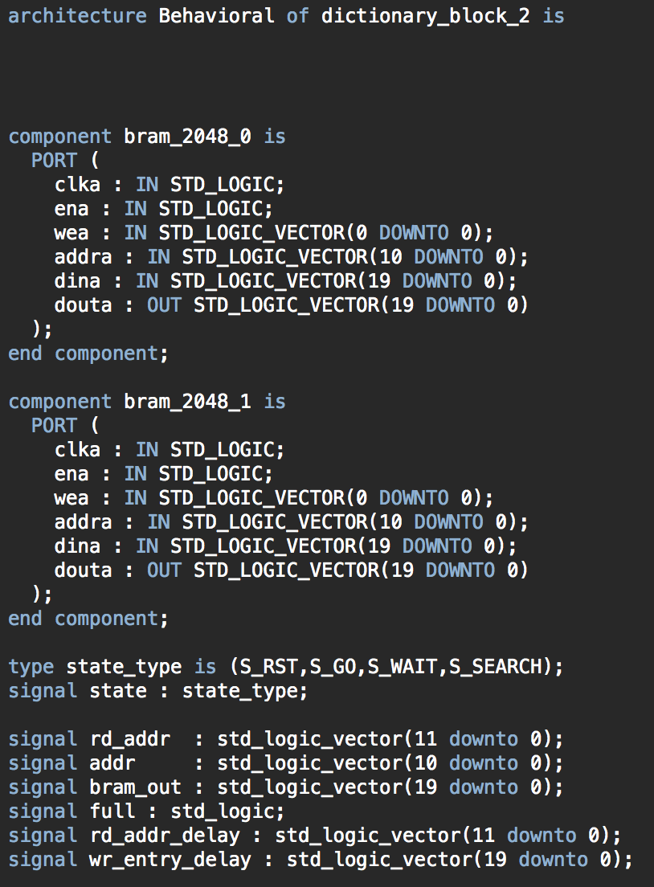
Dictionary – Two Dictionary Blocks

Slide 13
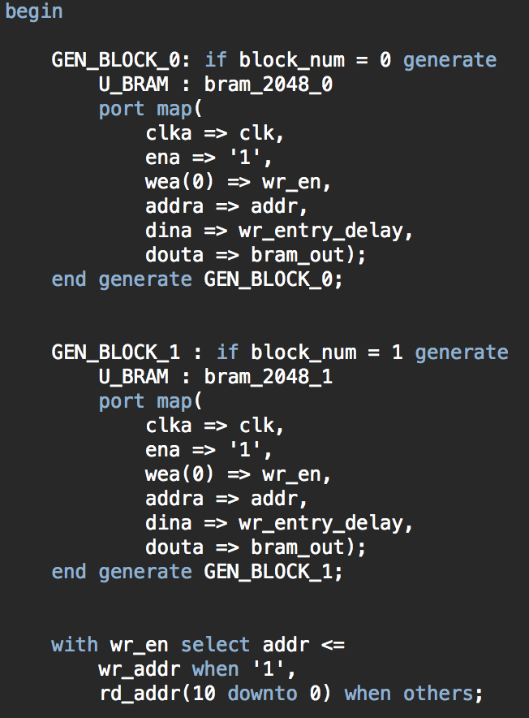
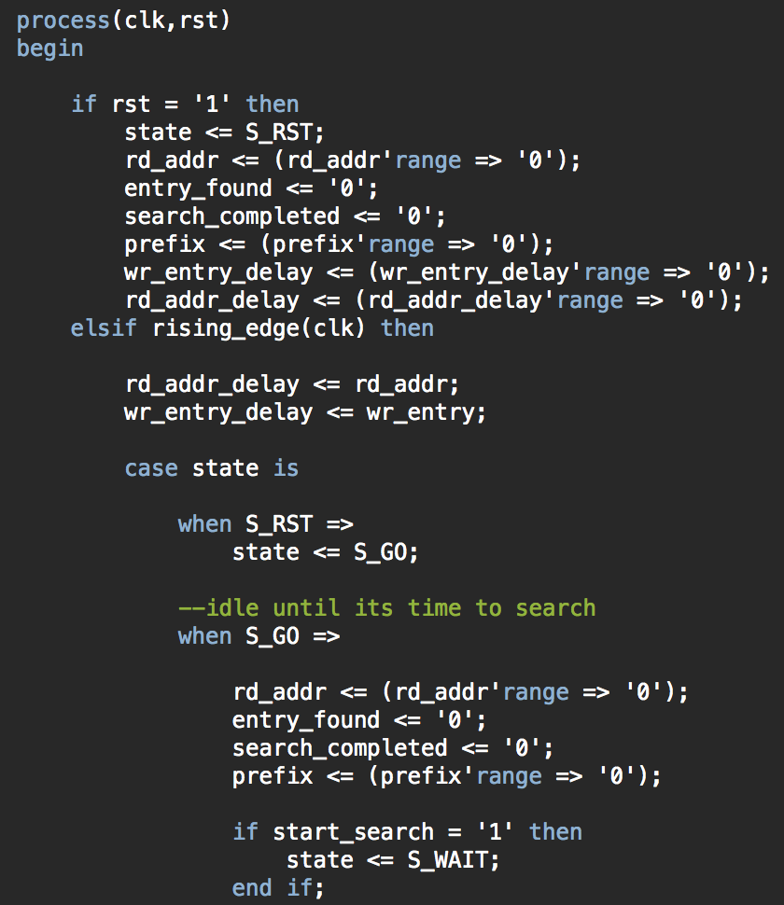
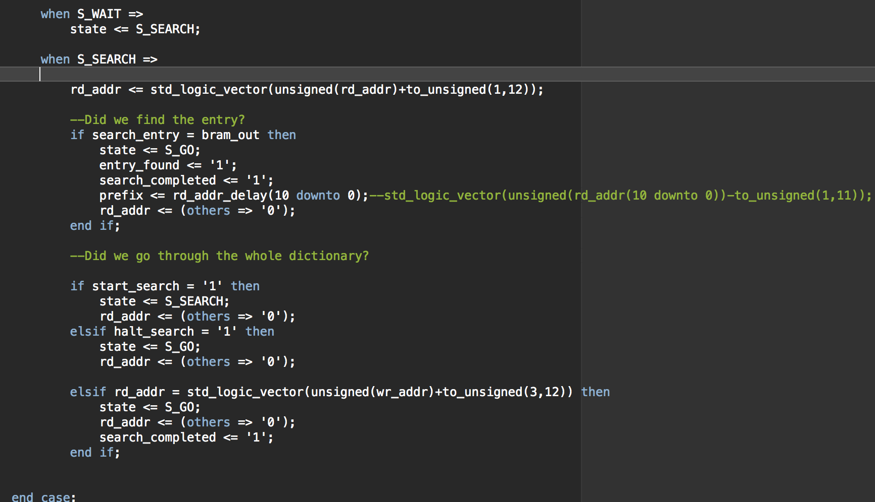
Dictionary – Two Dictionary Blocks

Slide 14
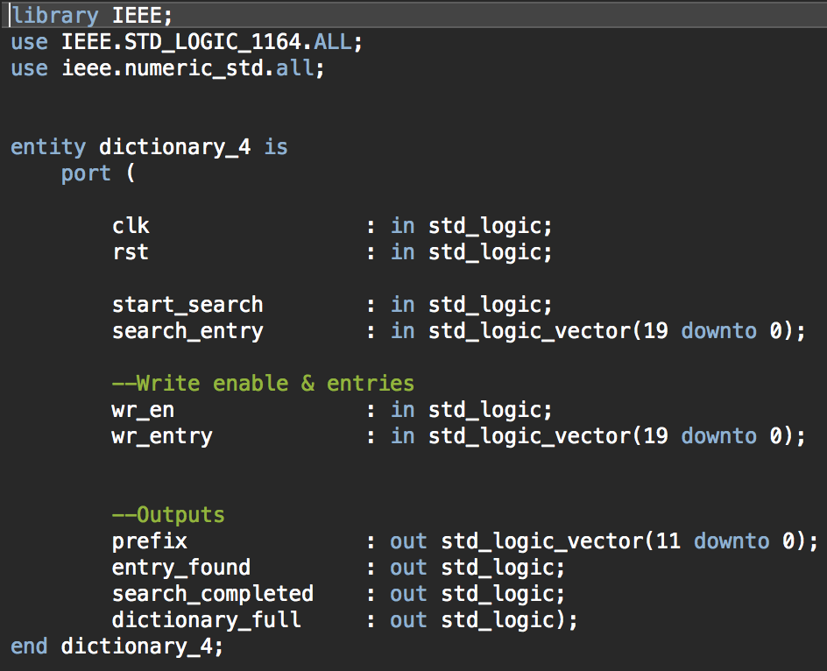
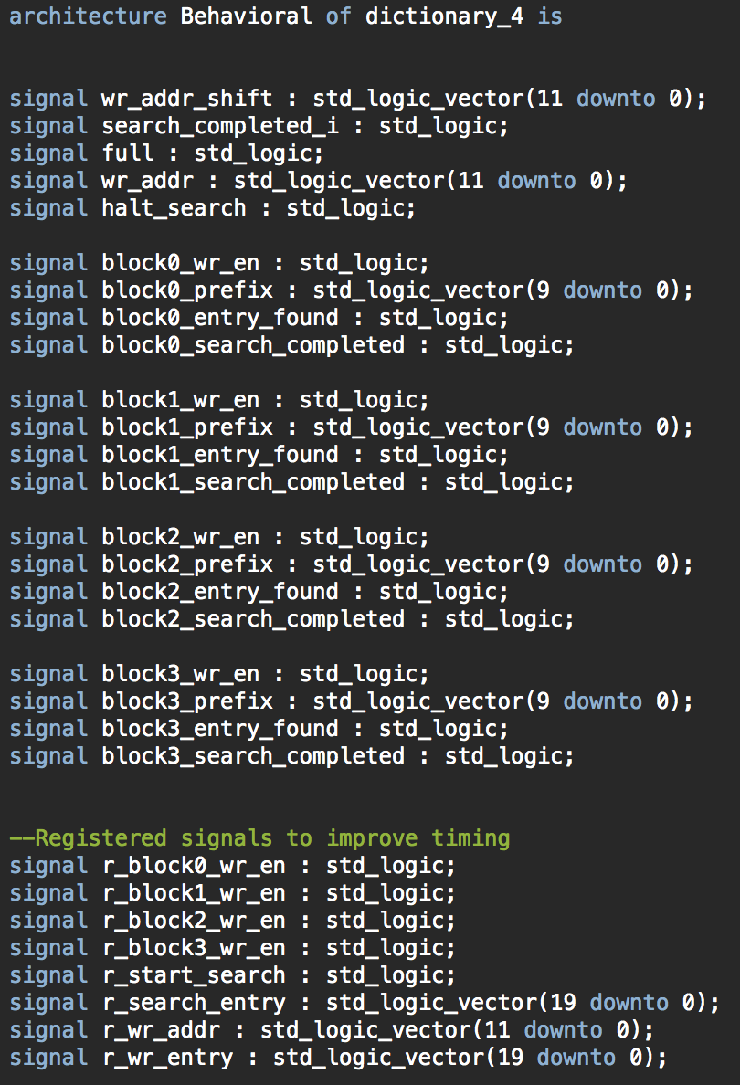
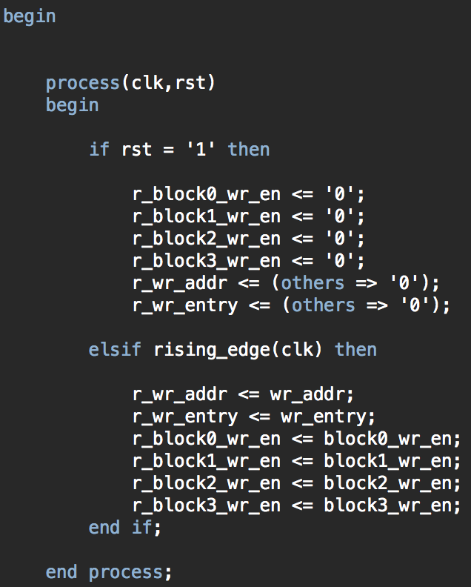
Dictionary – Four Dictionary Blocks

Slide 15
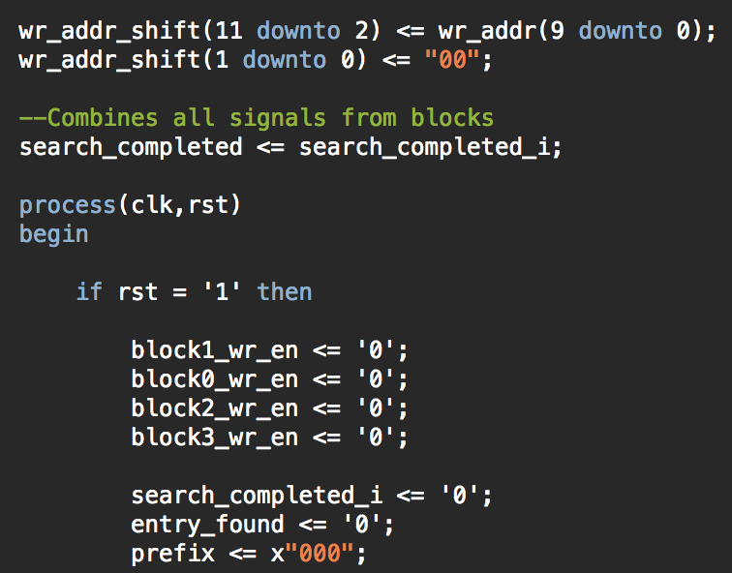
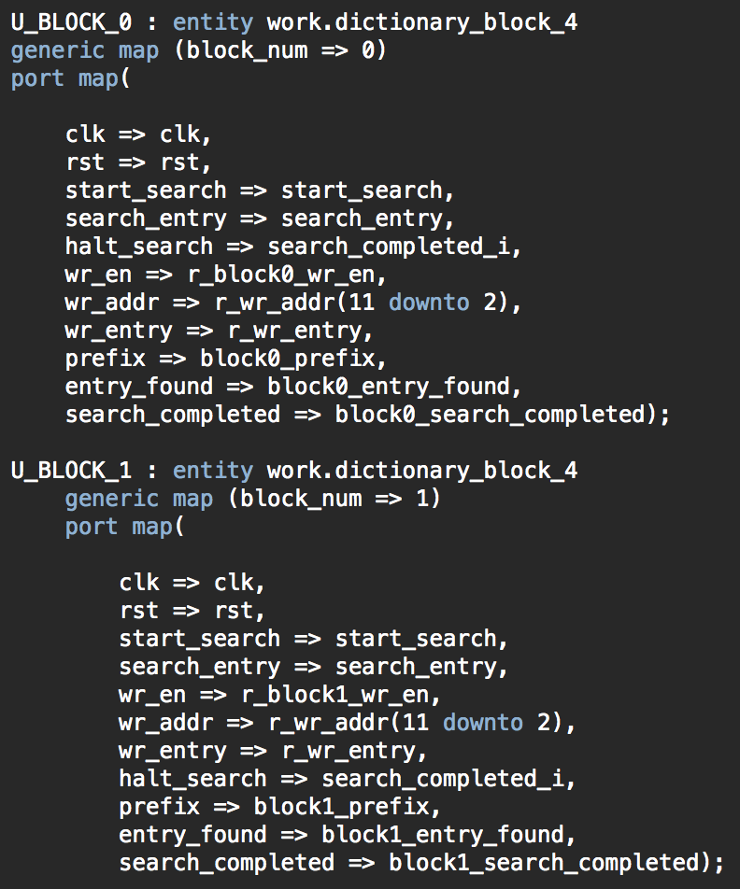
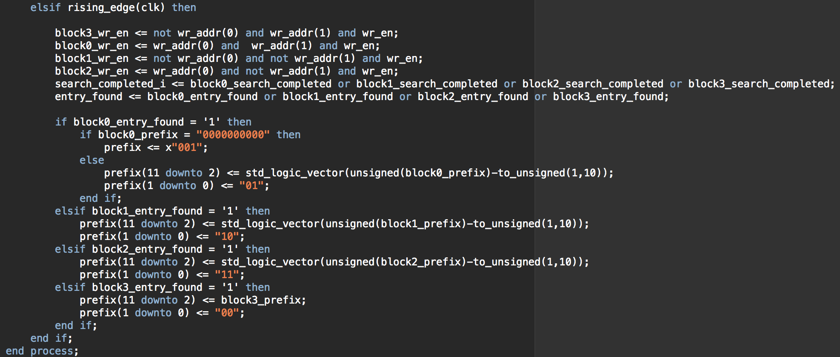
Dictionary – Four Dictionary Blocks

Slide 16
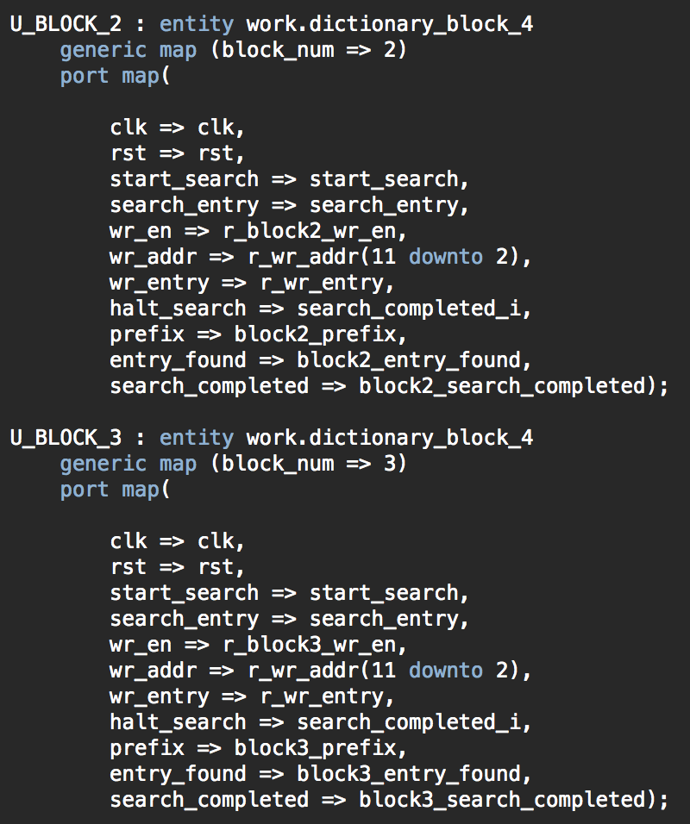
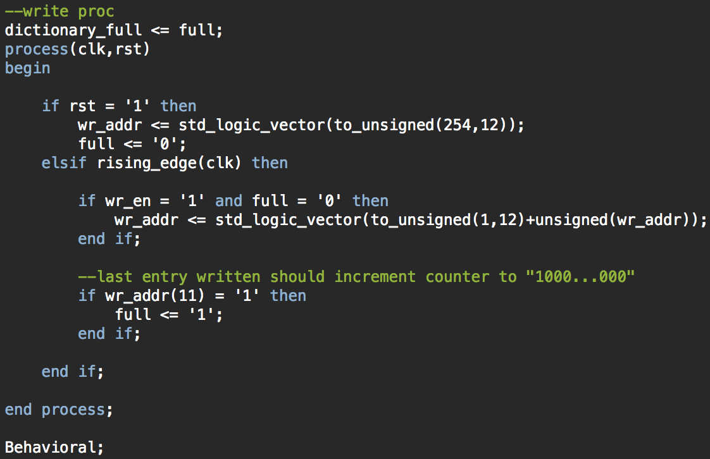
Dictionary – Four Dictionary Blocks

Slide 17
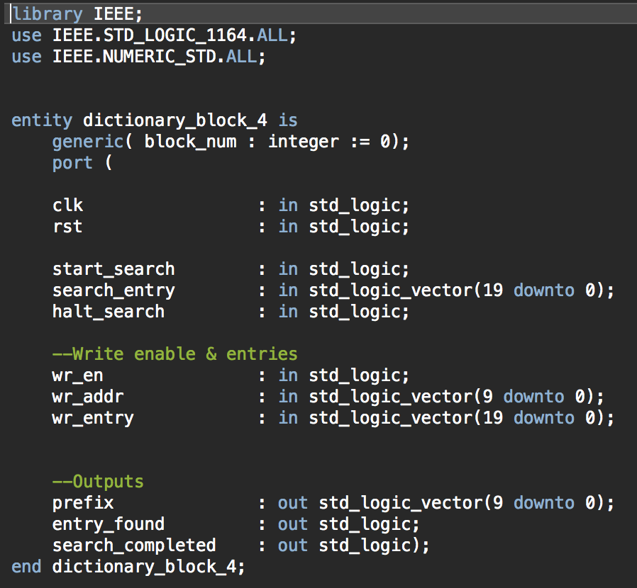
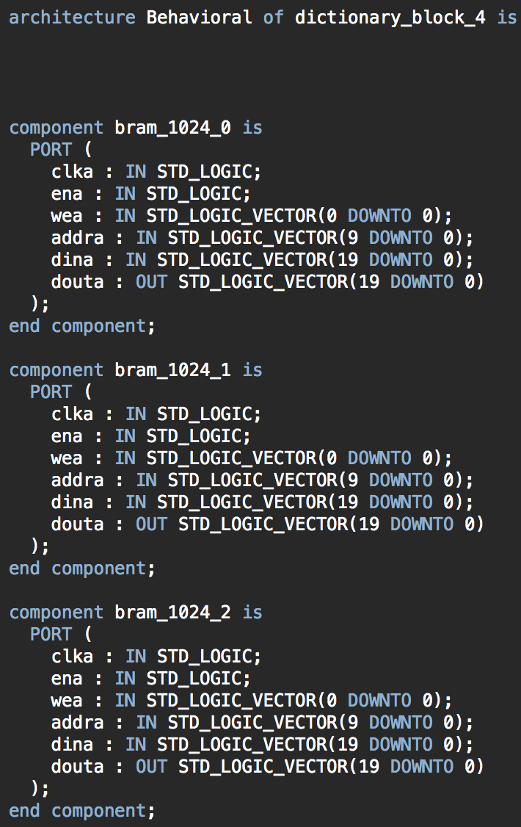
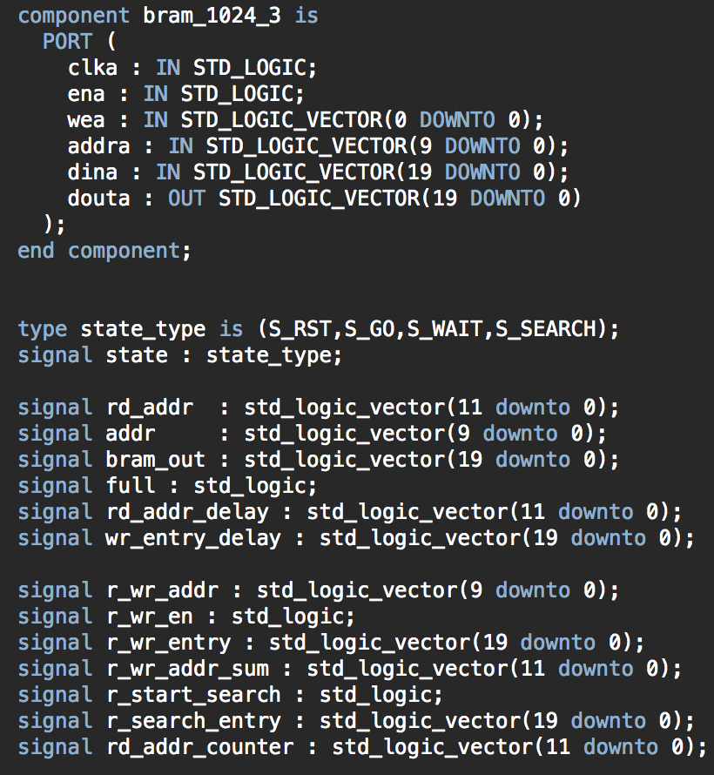
Dictionary – Four Dictionary Blocks

Slide 18
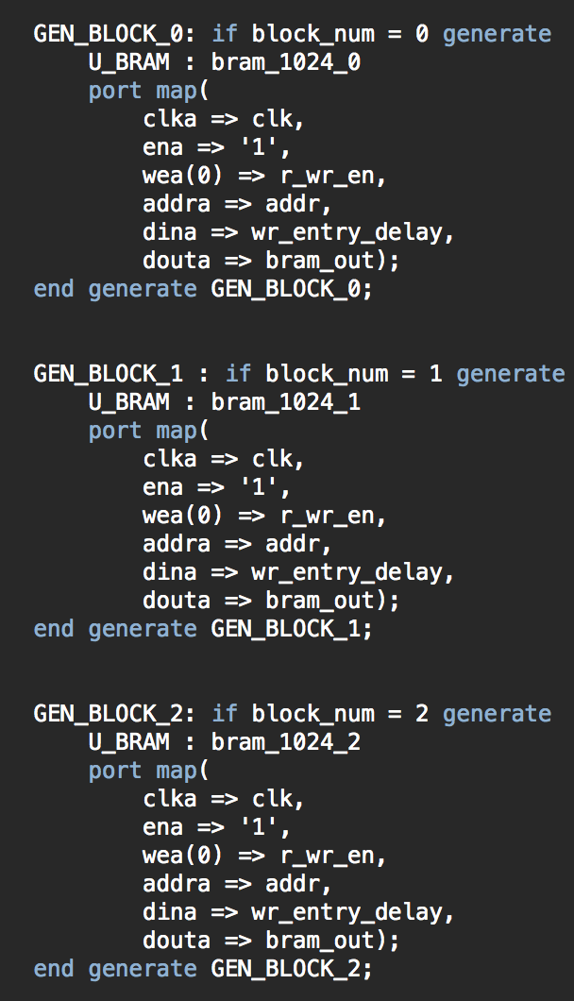
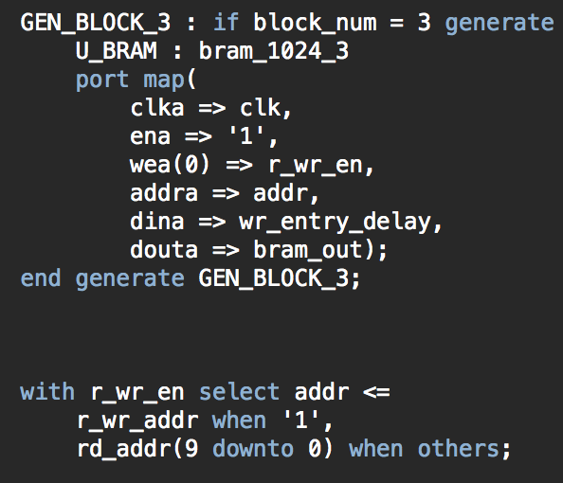
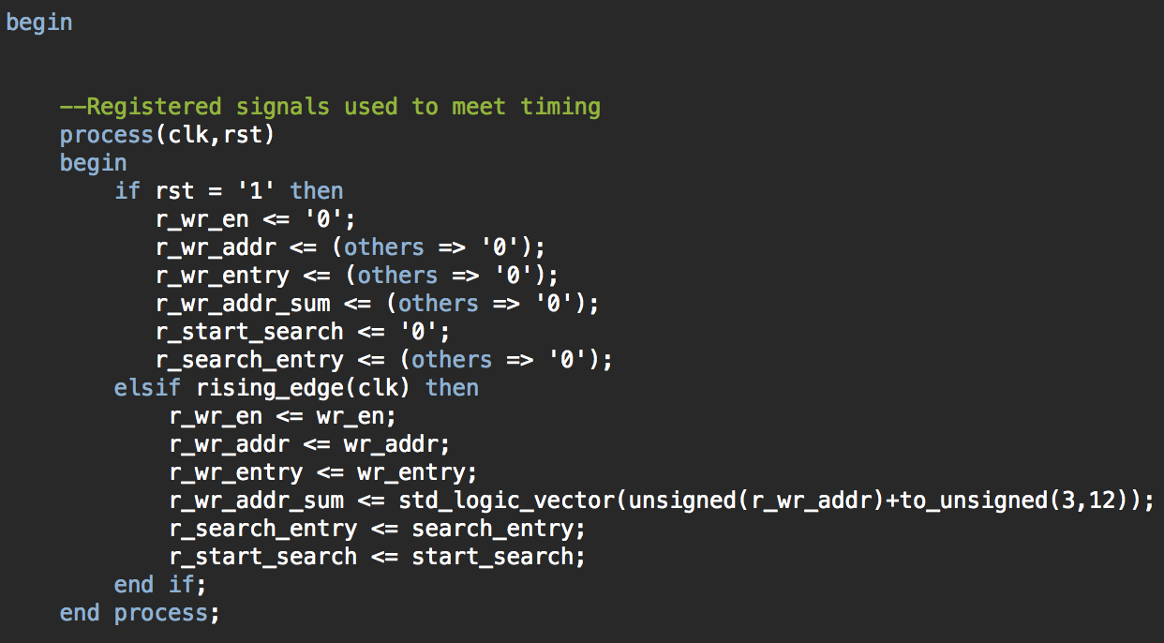
Dictionary – Four Dictionary Blocks

Slide 19
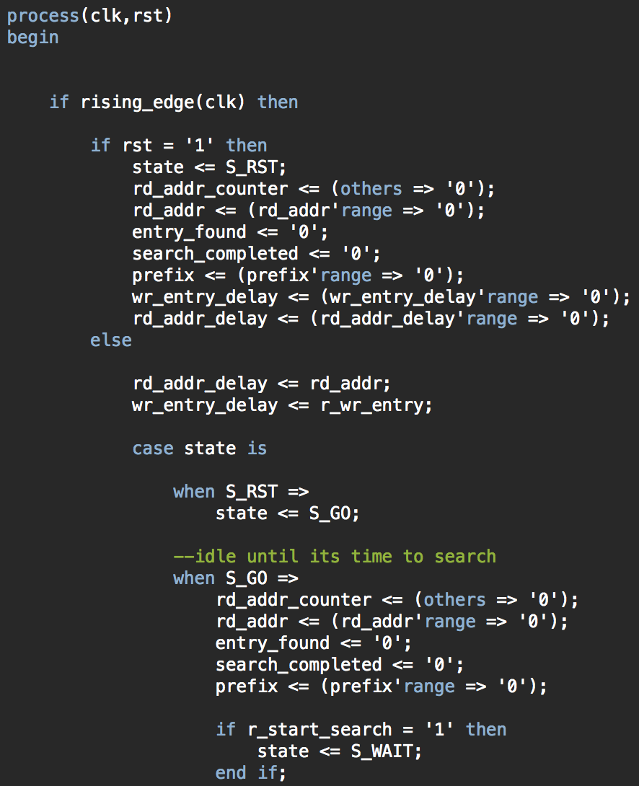
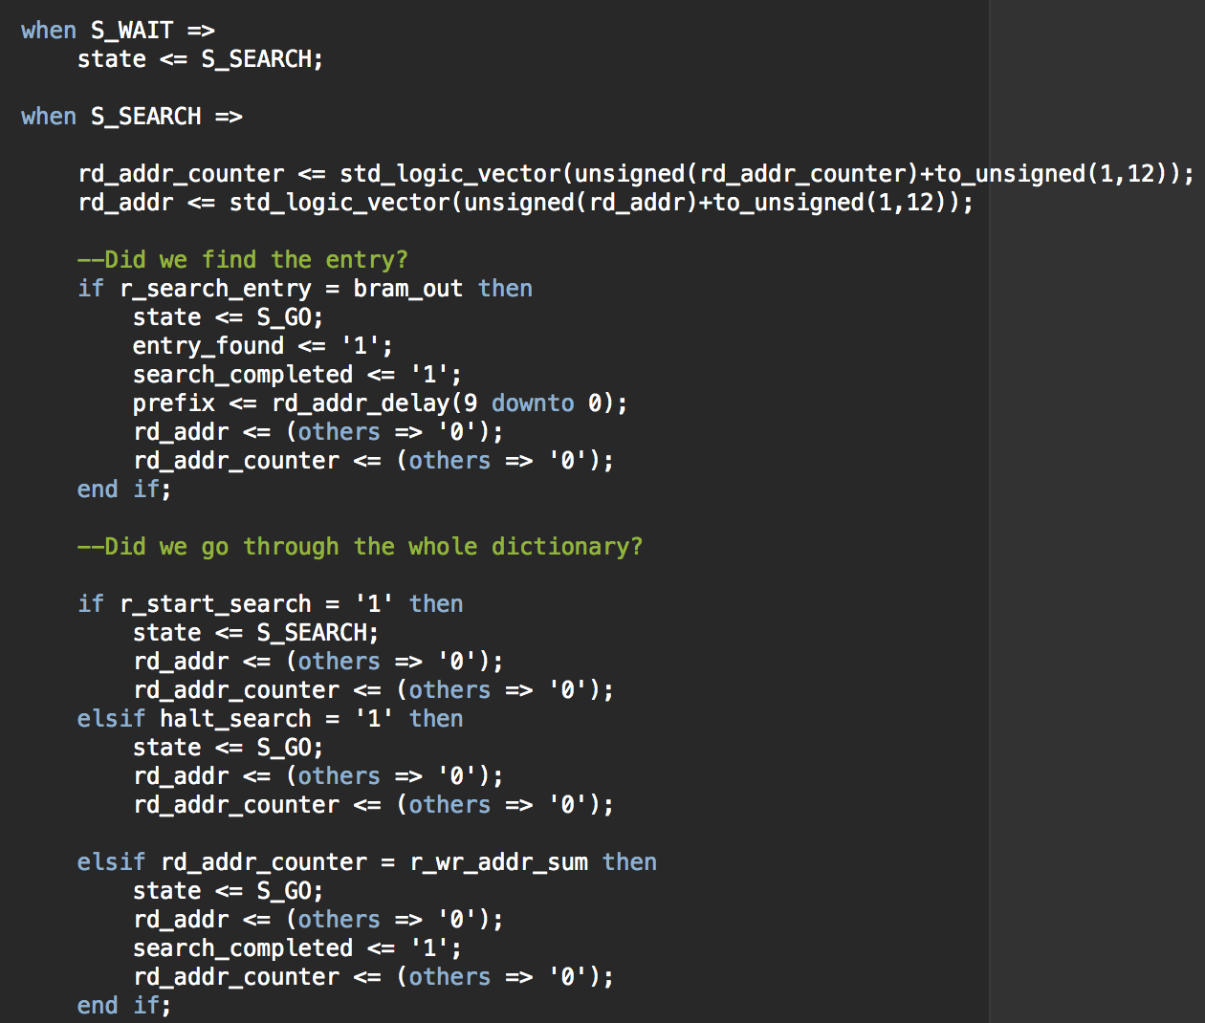
Dictionary – Four Dictionary Blocks

Slide 20
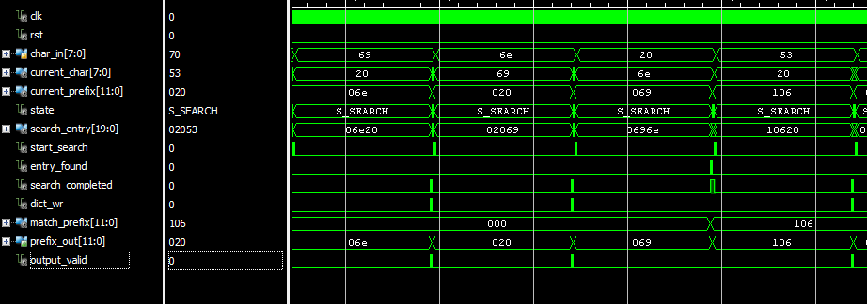
Parallel Dictionary Search Testing

Slide 21
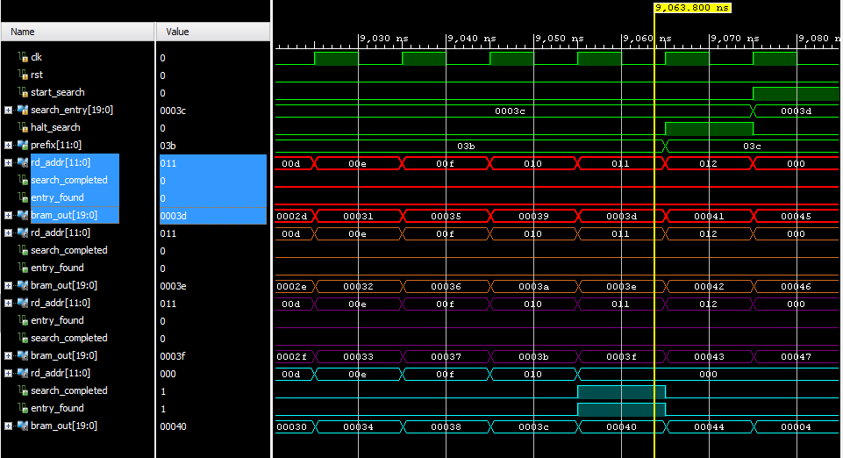
Parallel Dictionary Search Testing

Slide 22
Requirements Traceability Matrix
Test Cases
 |  | 1 | 2 | 3 | 4 | Completed
A | Read in compressed data in S/W from H/W | Read in data from a simple BRAM to confirm H/W S/W communication | Read in data from a FIFO to more accurately match final design |  |  | ✓
B | Able to search for dictionary entries and create new entries | Search for non-existent entries to make sure there is no false-positives | Search for valid entries within BRAM | Write new entries to dictionary | Search for newly written entries | ✓
C | Decompressed data exactly matches original data | Compare initial data in S/W to the result the S/W gets by decompressing the data it reads in from the H/W compression | Make sure the decompressed data matches the initial data exactly and is of the same size |  |  | ✓
Requirements

Slide 23
Requirements Traceability Matrix
Test Cases
 |  | 1 | 2 | 3 | 4 | Completed
D | Able to start project from S/W | Have a simple register that waits for a signal to write a specified value and tie that signal to S/W. Send the signal from S/W and confirm the register has written the new specified value | Have signal that starts the LZW compression, write to that signal in S/W and wait for the compressed data to be available to read in from S/W |  |  | ✓
E | Parallelize the Dictionary search | Search for non-existent entries to make sure there’s no false positives | Search for valid entries within BRAM. Check for cycle-count | Write new entries to dictionary | Search for newly written entries. Check for cycle-count reduction | ✓
F | Able to write original data to H/W from S/W to start compression | Connect a BRAM to S/W and write to it and read from it | Connect a FIFO to S/W and confirm we are able to read/write from it properly | Have LZW compression take place on data from FIFO that S/W has written the original data to |  | ✓
Requirements

Slide 24
Requirements Traceability Matrix
Test Cases
 |  | 1 | 2 | 3 | 4 | Completed
G | The compressed data is a smaller size than the original data | Compare the size of the original data | Confirm that the decompressed data matches the size of the original data |  |  | ✓
H | Compressed data from H/W matches the compressed data from our initial S/W implementation | Feed in the same input that we used for our software implementation and confirm that the compressed data matches |  |  |  | ✓
Requirements

Slide 25
Demo
Running on a ZedBoard
Different levels of parallel dictionary search
1 block
2 blocks
4 blocks

Slide 26
Questions?

